Slide 1
Java Syntax Introduction

Slide 2
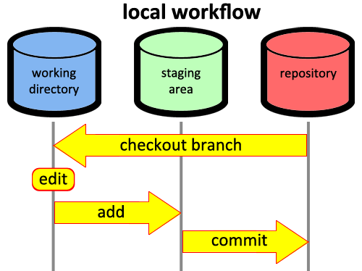

GIT and GitHub

Slide 3
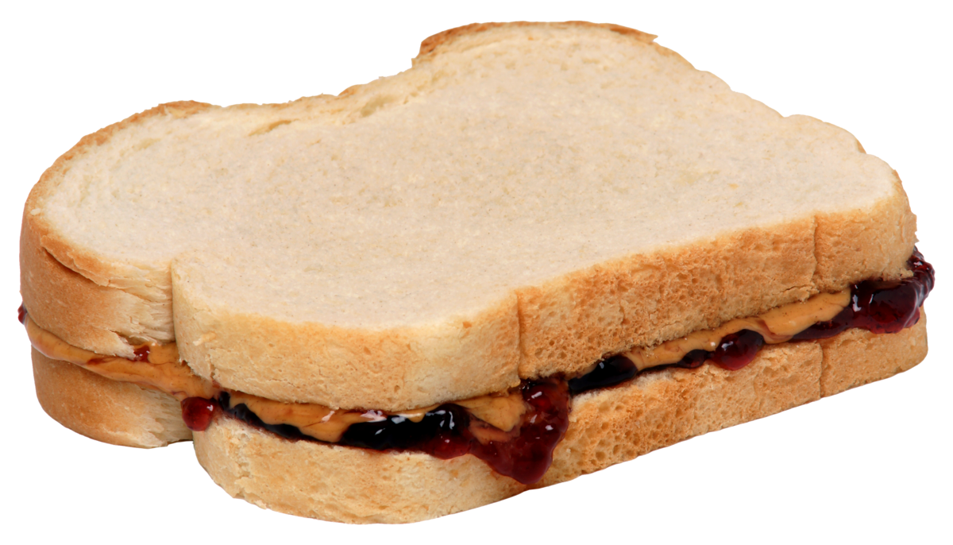
How do YOU make a sandwich?

Slide 4
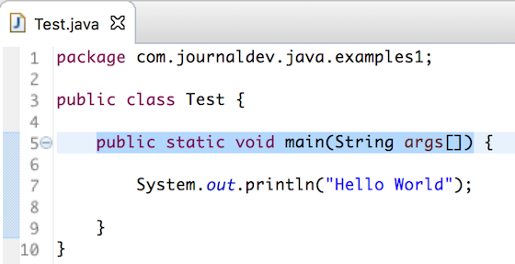
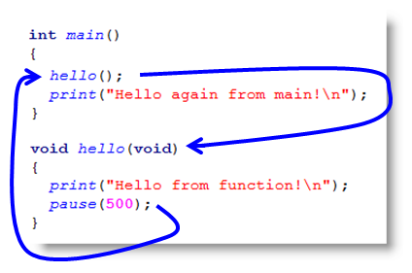
Main Function

Slide 5
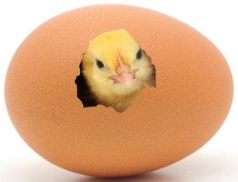
Hello World!

Slide 6
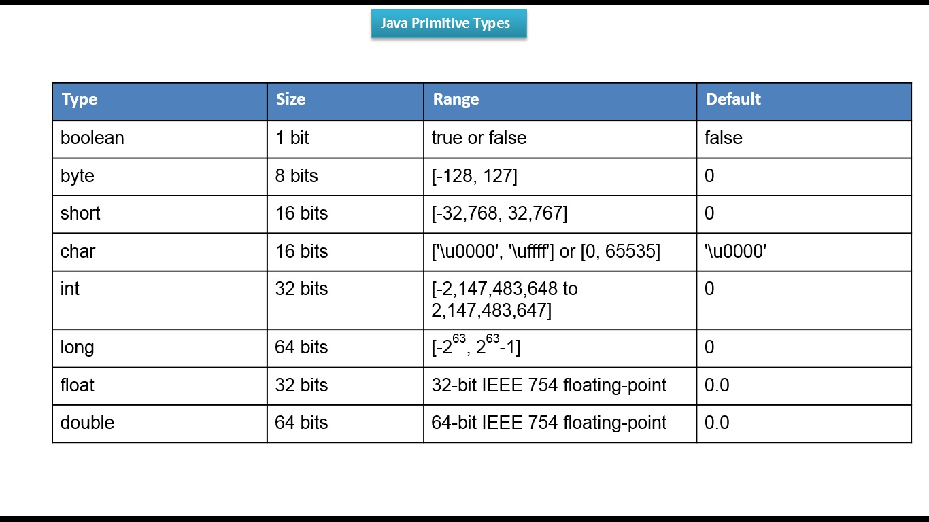
Primitive Data Types
String
String
String

Slide 7
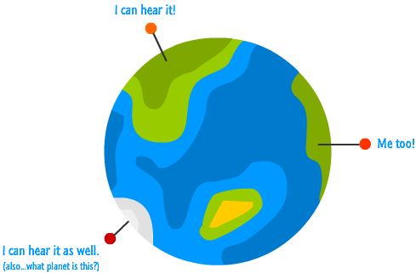
Variable Scope

Slide 8
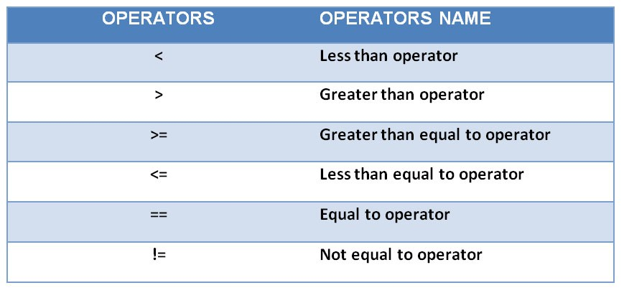
Equalities + Equality Operations

Slide 9

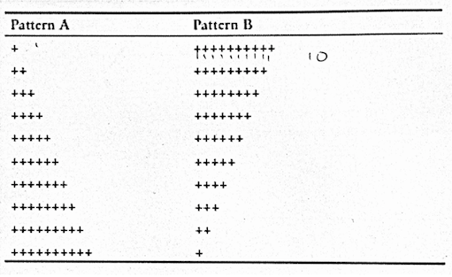
For Loops and While Loops

Slide 10
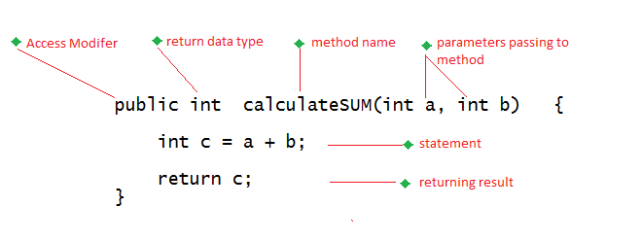
Methods

